Slide 1
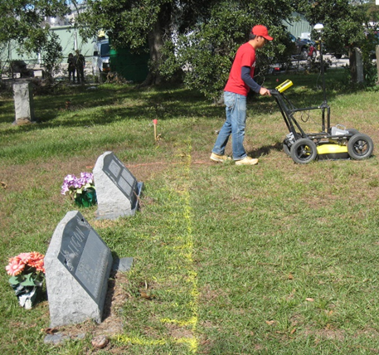
Ground penetrating radar imaging: Processing & case studies
Azie Aziz, Robert Stewart, and Susan Green
AGL Research Meeting
Hilton Hotel, University of Houston
April 2, 2014
Notes:
Good afternoon ladies and gentleman, my name is Azie and I am going to present some of my work on ground penetrating radar imaging: processing and case studies.

Slide 2
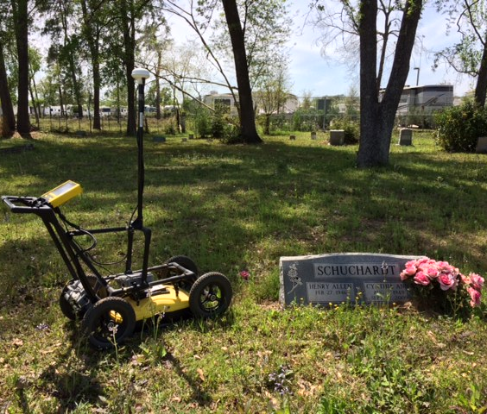
Outline
Introduction
Ground penetrating radar (GPR) overview
GPR data analysis cycle
Case studies
La Marque – culvert imaging
Mueschke Cemetery – detecting burials
Summary
Acknowledgement
Notes:
To begin with, This is the outline of presentation. I will begin by introducing the overview of GPR and what GPR data analysis cycle looks like.
Then, I will share the results from 2 case studies which are the imaging of buried culvert at La Marque. The second case history is the detection of leads of unmarked burials at Mueschke Cemetery.

Slide 3
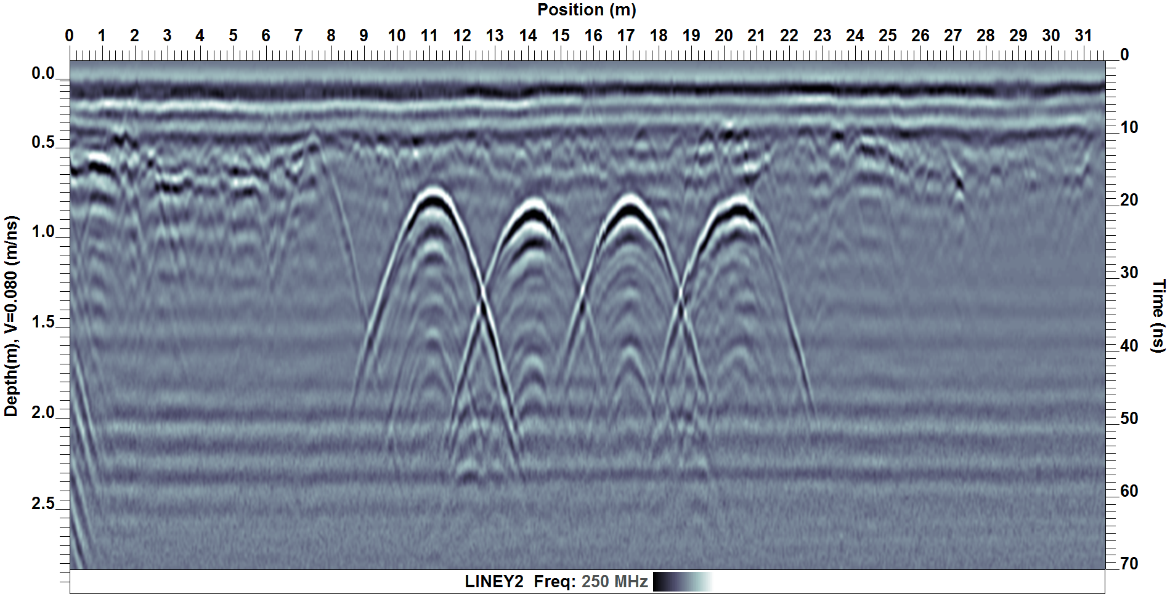
Ground penetrating radar (GPR)
Portable, fast, high-resolution & immediate imaging.
Frequency used: 100 MHz, 250 MHz & 1000 MHz.
Dielectric constant in North Houston is 3-12.
Soil composition is mostly clay.
Sensor & Software
Notes:
Ground Penetrating Radar or widely abbreviated as GPR is a geophysical technique that has been around for about 30 years ago. It is very fast, portable and produces a high-resolution image.
It provides a high resolution (vertical resolution=lambda/4)image but at the expense of the limited depth of penetration when we compare to seismic.
The antenna frequency I used is 100 MHz, 250 MHz and 1000 MHz. The maximum of depth of penetration is controlled by the antenna frequency and also the electrical properties of the medium.
EM wave propagation depends on the dielectric constant
On the slide, I am showing a cartoon of how a hyperbola is being constructed by pushing a GPR system over a void in a ground.

Slide 4
GPR data analysis procedure
Data acquisition
Data processing
Data analysis
Survey design
Frequency selection
Time zero correction
Deconvolution
Dewow
Gain
Filtering
Background removal
Forward modeling
Survey design
Velocity estimation
Migration
Data interpretation
Depth slice
3D
Resolution
Attribute analysis
Notes:
In GPR imaging, a basic step of data analysis is presented in the slide. We start with the data acquisition where we choose the appropriate antenna frequency and the line spacing if we are doing a 3D grid.
After acquiring the data, we apply data processing like time zero correction, deconvolution, dewow, gain and filtering to improve the raw data quality.
After processing, data analysis are performed based on the project objective to aid the data interpretation. For example, we can use forward modeling to help us to understand how a hyperbola of a specific target looks like on a radargram. Migration is also used to produce a more spatially realistic image if we are interested in an exact location like in locating a landmine. We can also estimate the vertical resolution or attribute analysis. Attribute helps us to remove the oscillatory nature of the wavelet and shows us the true resolution. Attribute can also helps us to emphasize the continuity of events.
Finally, in the interpretation stage, we can use the depth slice to observe the high amplitude area. Velocity estimation by matching the hyperbola is also helpful in finding the formation velocity.

Slide 5
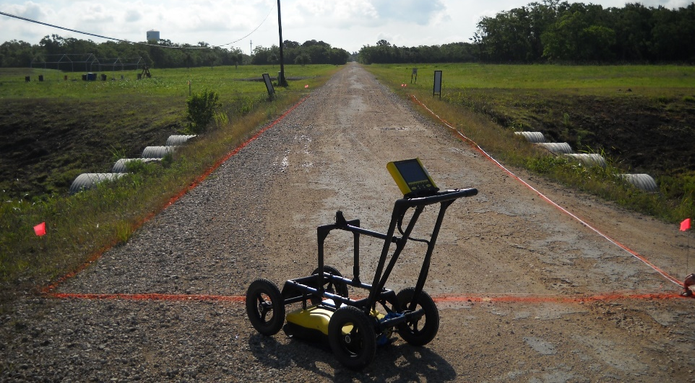
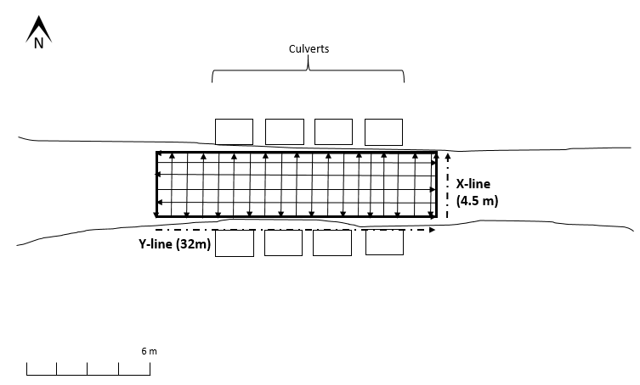
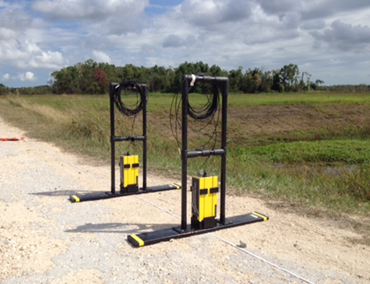
Case 1: La Marque – culvert imaging
a
b
W
E
0.75 m
2.50 m
3.30 m
Culvert
250 MHz
c
d
3D grid
100 MHz
Notes:
Here is the first case study which is my first training in working with GPR. My objective is to image 4 buried culverts at la Marque, 30 miles south of Houston. The target is obvious. The culvert is made of metal and metal will reflect all the radar energy and shadow anything beneath it. The physical measurement shows the top of the culvert is 0.75 m deep.
A mixture of crushed limestone and oyster shells covers the first 15 cm of the top of the surface road. A stabilizer sand was used to fill the remaining space to the top of the culverts.
We did 2 types of surveys : reflection and also CMP
The acquisition was done in two different days during the summer 2013 where 250 MHz data was acquired in the first day and the remaining was done on the second day. The weather on the first day was humid (82 percent humidity) with an average temperature of 28º C. The average wind was 9 mph with no rain. However, it was raining the night before with 0.44 inch of precipitation so the soil is saturated. The second day weather was dry with no rain and the average temperature was 30º F.

Slide 6
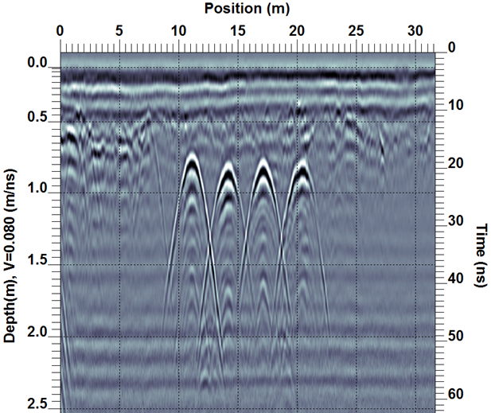
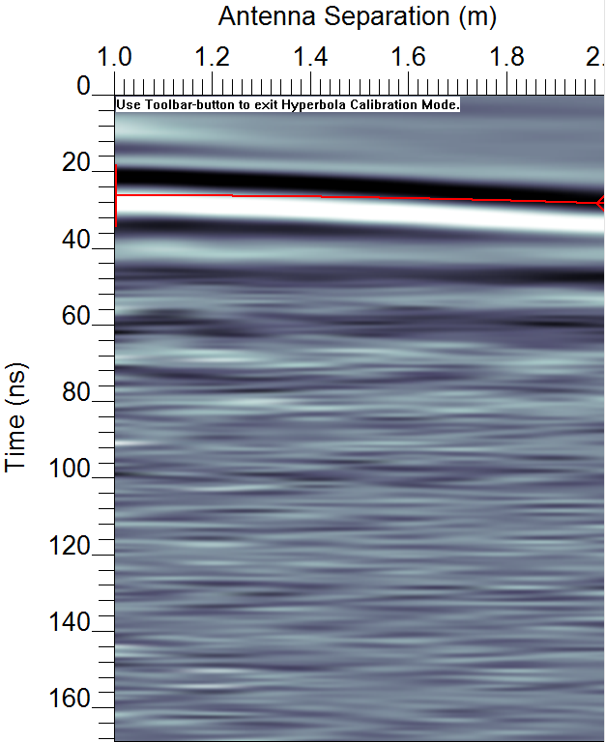
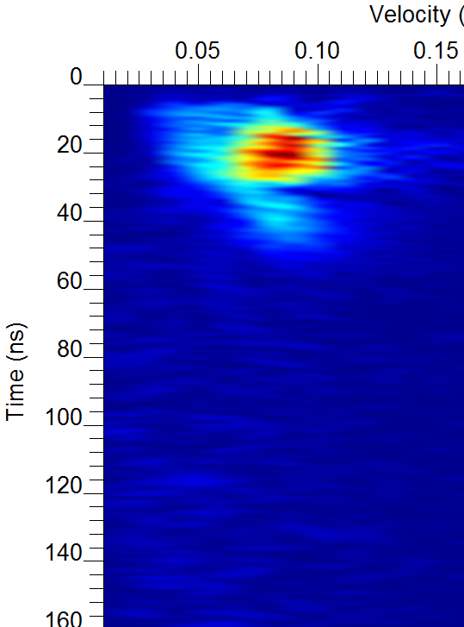
Velocity estimation
a) Hyperbola fitting
b) CMP
c) Velocity semblance
V = 0.08 m/ns
V = 0.08 m/ns
V = 0.10 m/ns
Notes:
In order to do the time to depth conversion, we need the velocity of the soil. In GPR, we can do hyperbola fitting on the radargram. However, since a culvert is not a point source, the hyperbola fitting will not be accurate. Therefore, I performed a common midpoint or walkaway survey.

Slide 7
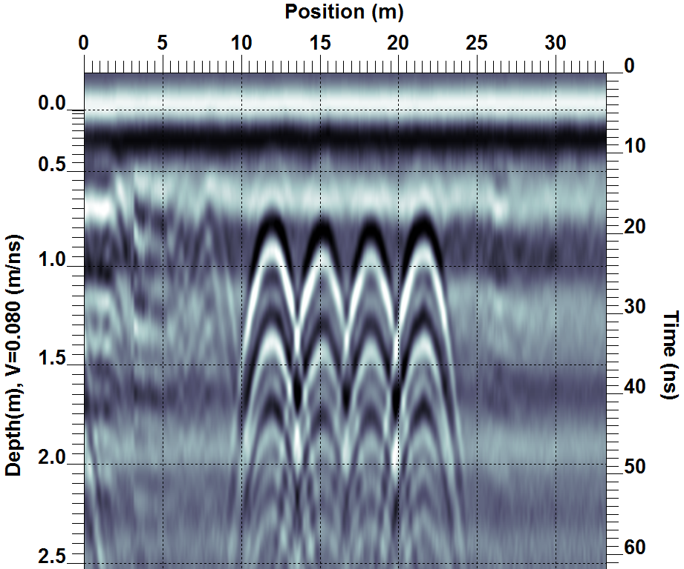
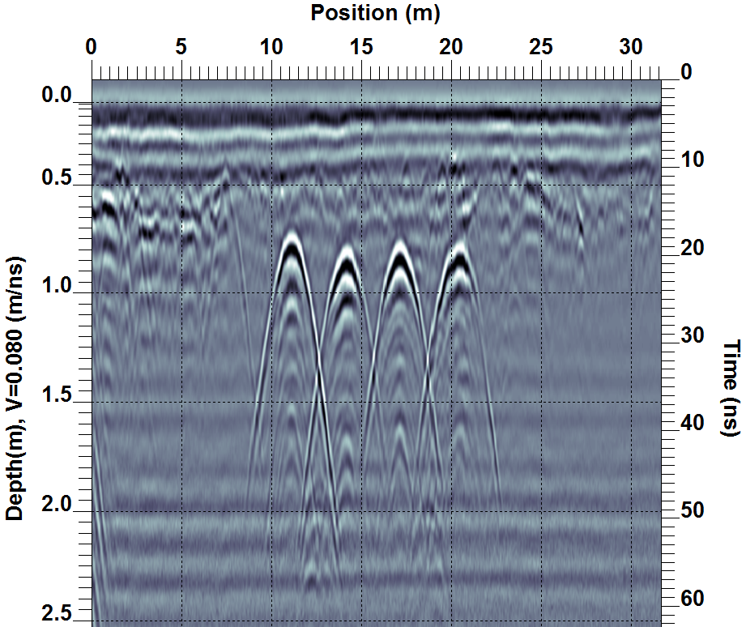
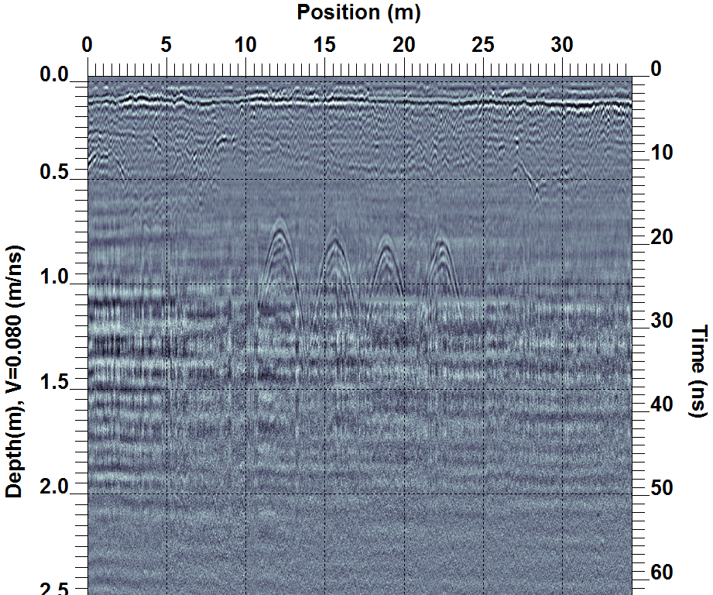
Image comparison of frequencies
a) 100 MHz
b) 250 MHz
c) 1000 MHz
Notes:
Here is the result of the three different frequencies after being processed.
The vertical scale on the left is depth and on the right is time in nano second.
We can see all the culvert tops on all the images.
In figure a, the resolution is the least compared to other images. We cannot distinguish the difference between the depth of the culvert tops.
The resolution of the image diminishes after 60 ns as the signal amplitude reaches the background noise level.
The 250 MHz shielded antenna provides a clear image with vertical resolution of about 0.1 m. The 100 MHz antenna gives a greater penetration, but with substantially diminished resolution (about 0.25m). For imaging the culvert, the 250 MHz system is most effective.
Figure c shows the result of 1000 MHz antenna, which still shows the tops of all the culverts. The signal is very weak after 30 ns and it is just above the background noise level. For 1 GHz, the top of the culvert was clearly imaged on the radargram but overall penetration depth is limited and the noise level is relatively high.

Slide 8
Forward modeling of adjacent culverts
a) GPR data
b) GPR modeling
c) Modeling result
Interference
Notes:
One interesting observation is a presence of a third hyperbola between adjacent culverts. Adjacent culverts created interference when the radar wave interacts with one of the pipes (Porsani and Sauck, 2006). The interference creates an artifact between the adjacent pipes. To demonstrate the effect of the interference due to the adjacent culverts, we conducted 2D numerical simulation. We consider the simulation geometry and model parameters as shown in Figure 2a. The artifact can be observed in both GPR data and in the modeling as illustrated in Figure 2b.

Slide 9
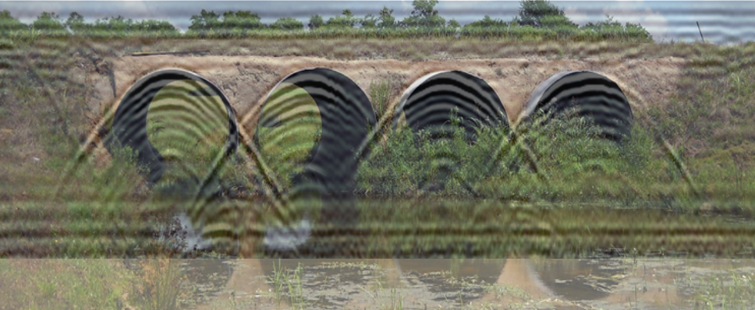
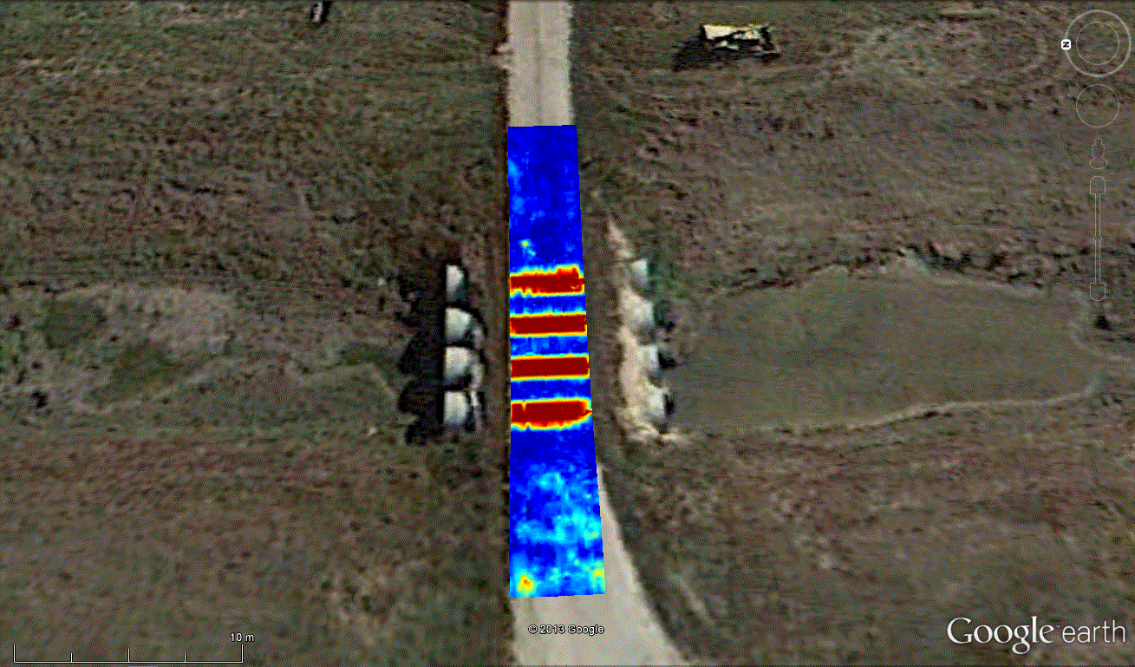
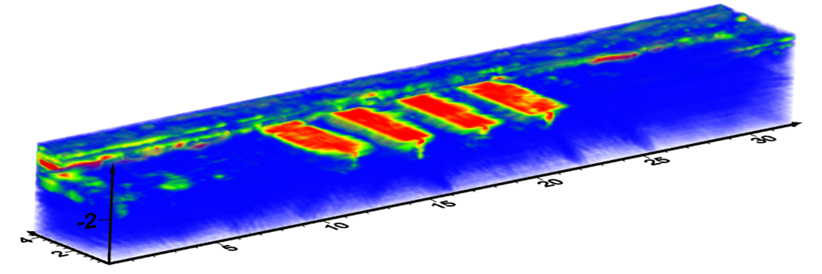
Interpretation of culverts
a) GPR section overlain on the photograph of culvert
Green arrows show top of culverts
b) GPR depth slice overlain on Google Earth
c) 3D GPR depth slice
Notes:
Finally, I used 3 ways to interpret the culverts.
In figure a, I overlaid the GPR section on a photograph of the culvert and they match very nicely. In figure b, I exported the depth slice onto Google Earth and the culverts which are represented by the high amplitude areas (in red) are aligned with the culvert on Google Earth.
In figure c, culvert can be displayed in 3D.

Slide 10
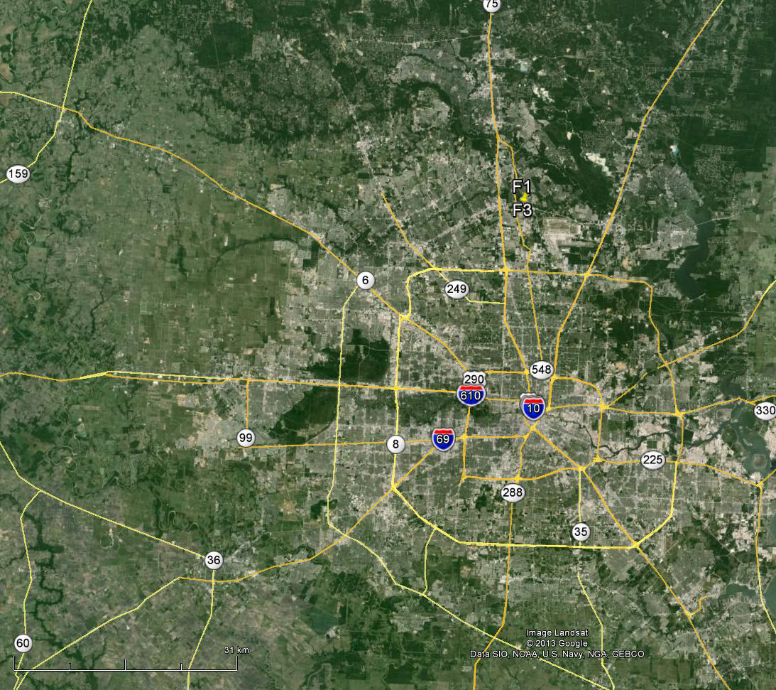
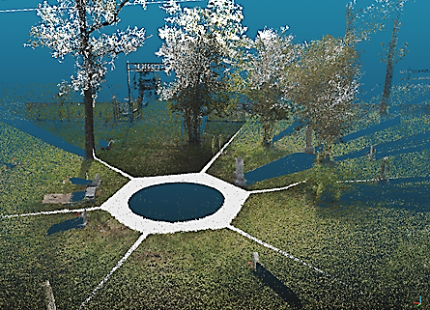
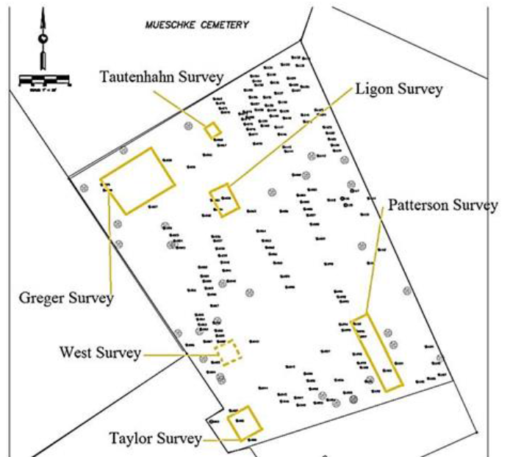
Case study 1: Mueschke Cemetery
Searching for missing burials at Mueschke Cemetery, Houston, Texas
Mueschke Cemetery
Lidar scanner
Headstone
Headstone
Lidar image
Notes:
Now I am going to show a second case study which is more challenging in terms of the soil and also the target. It is a collaboration project between UH and Lone Star College to assist the Mueschke Cemetery Associaltion in its preservation effort. The cemetery us located 26 miles north of Houston. The left figure shows the survey location with respect to Houston map. The inset shows the 6 survey grids and also the burial record. The figure on the right is a picture from Lidar survey in the area. It is the picture of the intensity of every single point being shot. The hexagon shape is where the Lidar unit was positioned during the survey. We can see the tombstones, shadows of the tombstones, tress.

Slide 11
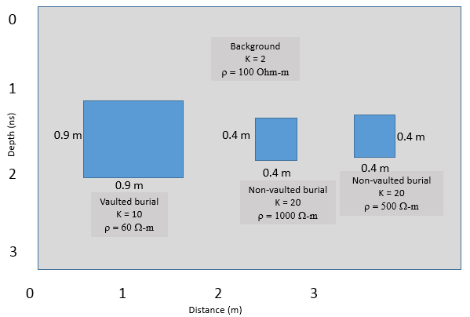
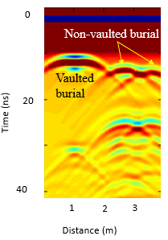
Forward modeling of burials
a) GPR modeling
b) Modeling result
Notes:
There are two different type of burials. One is burials before 1940 and the other one is after 1940 which is concrete vaulted to prevent it from sinking . Burials before 1940 is just wooden coffin. We would like to see the burials look like on GPR radargram and hence we did the forward modeling. I modeled 3 burials and figure b shows the radargram of the modeling. The hyperbola of vaulted burial is more like a rectangular shape while the other 2 have a smooth hyperbola. So now we can expect
We used 2-D finite-difference time domain (FDTD) to simulate the full wavefield GPR responses. The synthetic models are built to help us to understand the effect of the attenuation to the received signal attributed to the soil type and moisture content and to identify GPR signature of different type of burials. We used MATGPR simulation to perform the forward model.
The left image is the electromagnetic model. We have 2 types of burials. Concrete vaulted and non-vaulted burials. Burials prior to 1940 is not concrete vaulted and burials after 1940 is concrete vauted. We are expecting to see 2 different GPr signatures for both burials. The vaulted burials have a more rectangular shaped hyperbola if compared to the non-vaulted. That is a sign we need to find out.

Slide 12
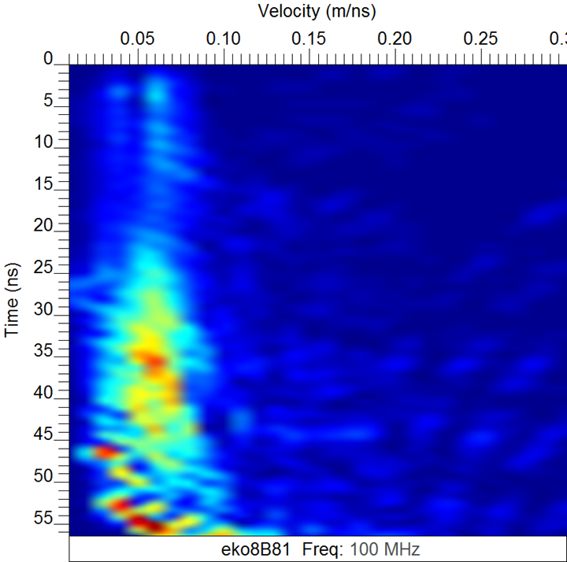
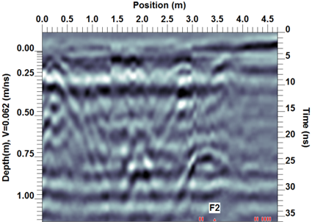
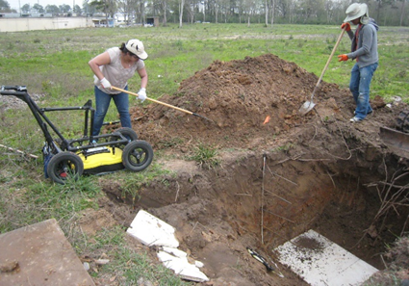
Velocity estimation of the soil
Three methods :
Time-to-depth
CMP
Hyperbola fitting
CMP
Time to depth at 0.75 m
Tree root
Tree root
Tree root
V = 0.06 m/ns
Tree root
Rebar
V = 0.06 m/ns
Rebar
Closure
Notes:
We used three methods to determine the velocity of the soil. One method is excavate a pit and we bury rebar at known depths and then we run a GPR survey over it. We can use hyperbola fitting to estimate the velocity of the soil because the rebar is a point source. Since we know the depth of the rebar and we have the hyperbola caused by the reflection of the rebar, we can estimate the velocity.
The other method is to do a CMP survey. The CMP survey yields 0.06 m/ns velocity from the velocity semblance analysis.
Three methods were used to estimate the soil velocity: CMP, time-to-depth and hyperbola fitting. Time-to-depth was done by burying rebar at several known depths. These methods yielded a soil velocity of 0.06 m/ns.

Slide 13
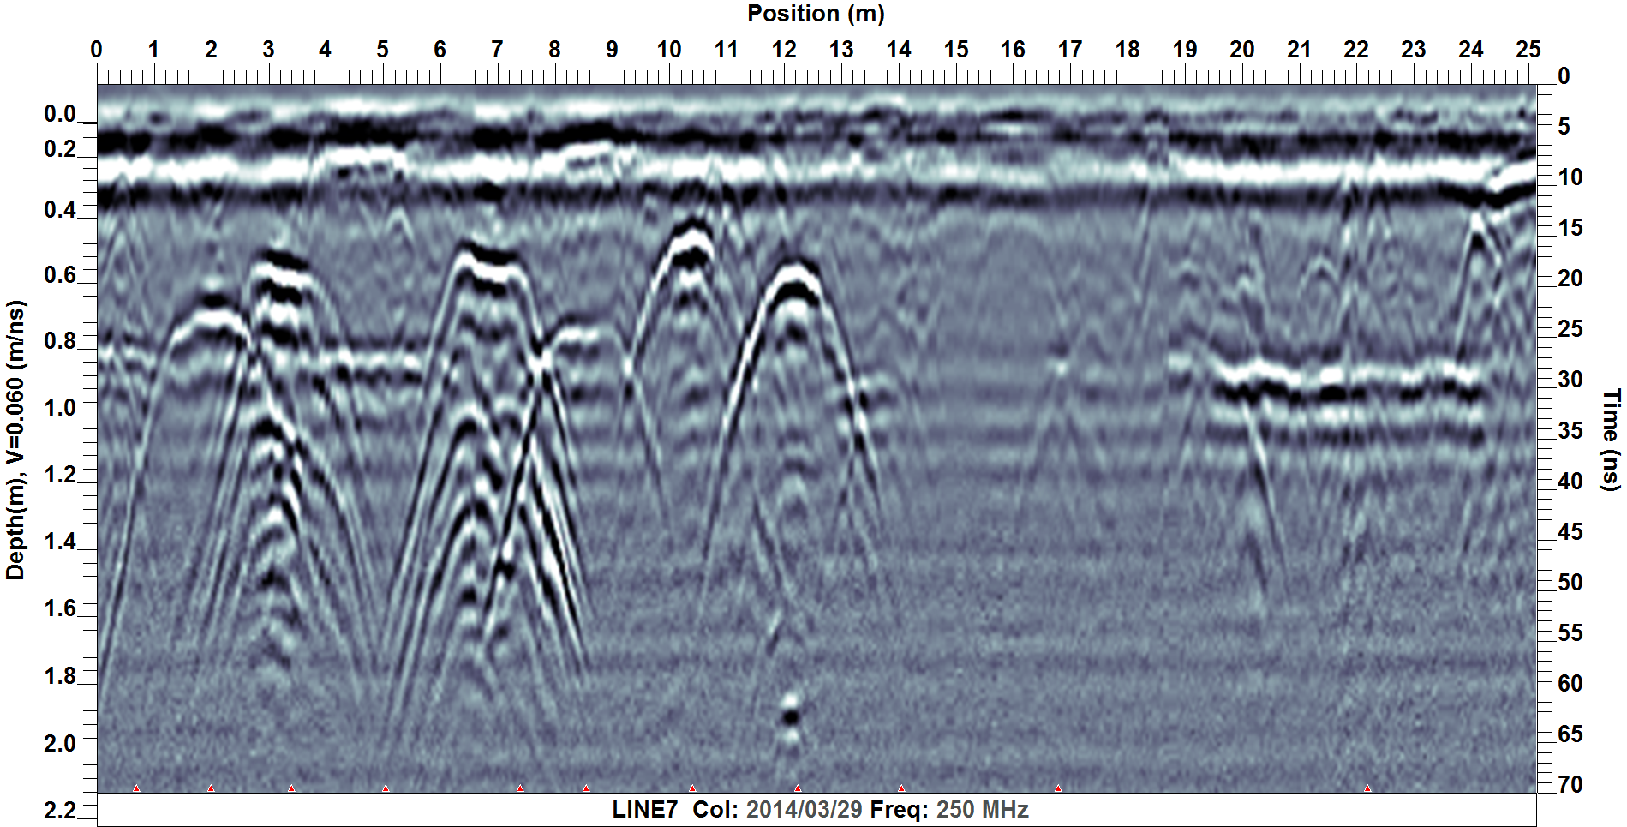
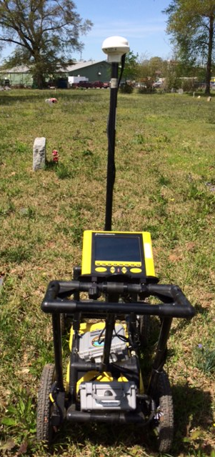
GPR signature: vaulted & non-vaulted
N
S
GPR section
N
Prior to 1940
After 1940
GPR line
Notes:
To be able to detect the leads for the unmarked burials, we need to know how the type of burials look like. I ran a GPR along a line whichhave burials prior to 1940 and after 1940. Here is the GPR image of the burials. Yellow marker shows the burials after 1940 which are believed to be concrete vaulted. The first three burials are dated between 2001-2009. The burials which have the hyperbola shape are dated in 1960s.
We cannot see a distinct hyperbola for the burials after 1940. This is the challenge in detecting leads of the burials prior to 1940.
2009
2005
2001
1989
1964
1963
1942

Slide 14
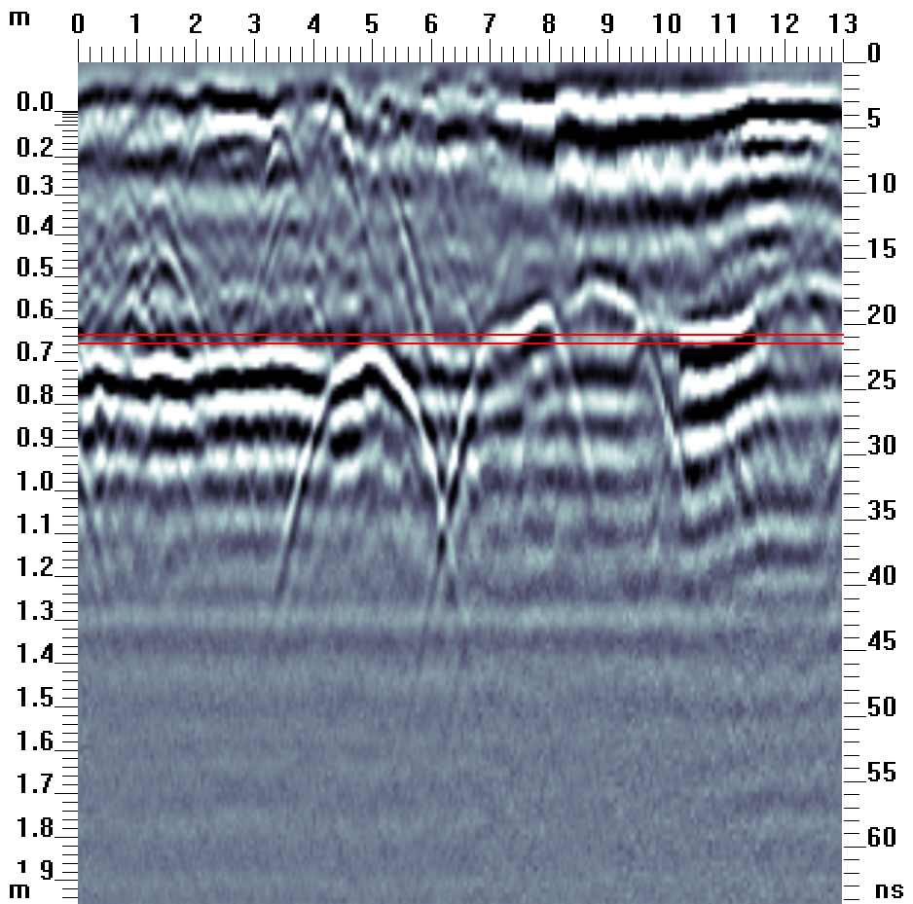
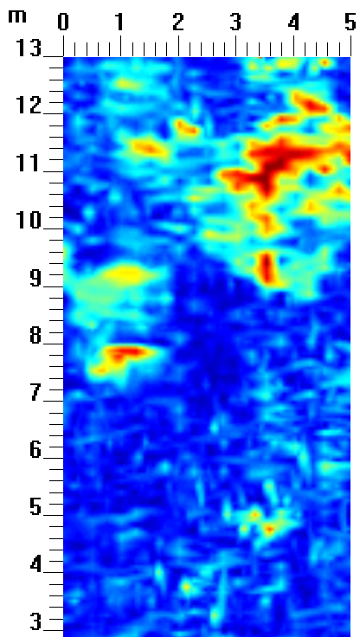
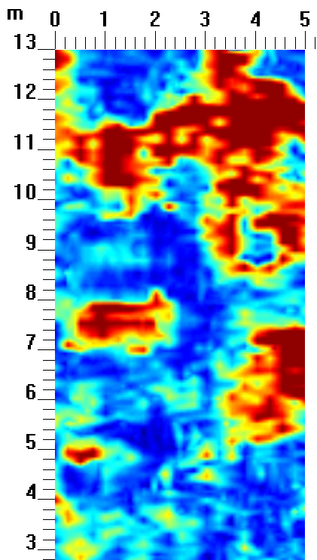
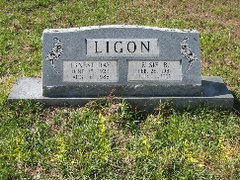
Result :Template survey
GPR section
Depth = 0.57 m
Depth = 0.65 m
Nelson
RIP:1979
Ernest
RIP:1988
Elsie
RIP:2007
B
C
A
C
B
B
A
Notes:
A profile from the Ligon survey is used as an example. The GPR data were processed using dewow, background removal and SEC2 gain. The processed data show three diagnostic diffraction hyperbolas which indicate the top of the coffins. Figure on your left shows the 2D reflection profile of the Ligon survey representing one transect to the east of 2 headstones marking 3 known burials (Nelsen (A), Ernest (B) and Elsie (C)). The hyperbola tops are recorded at different depth due to the varying burial time. Deeper burial is related to earlier burial. Figure 7a shows the depth slice at 0.57 m corresponding to burial B and C which are marked by the rectangular box on the slice. Figure 7b indicates burial A and B at 0.65 m. The high amplitude area on the top right corner of the slice is interpreted as the transition zone where
the soil transitions to a higher clay content. The top of the burial is clearly imaged although the soil is mainly clay as found during the excavation which is the limiting factor to GPR resolution. We used this template to identify unmarke

Slide 15
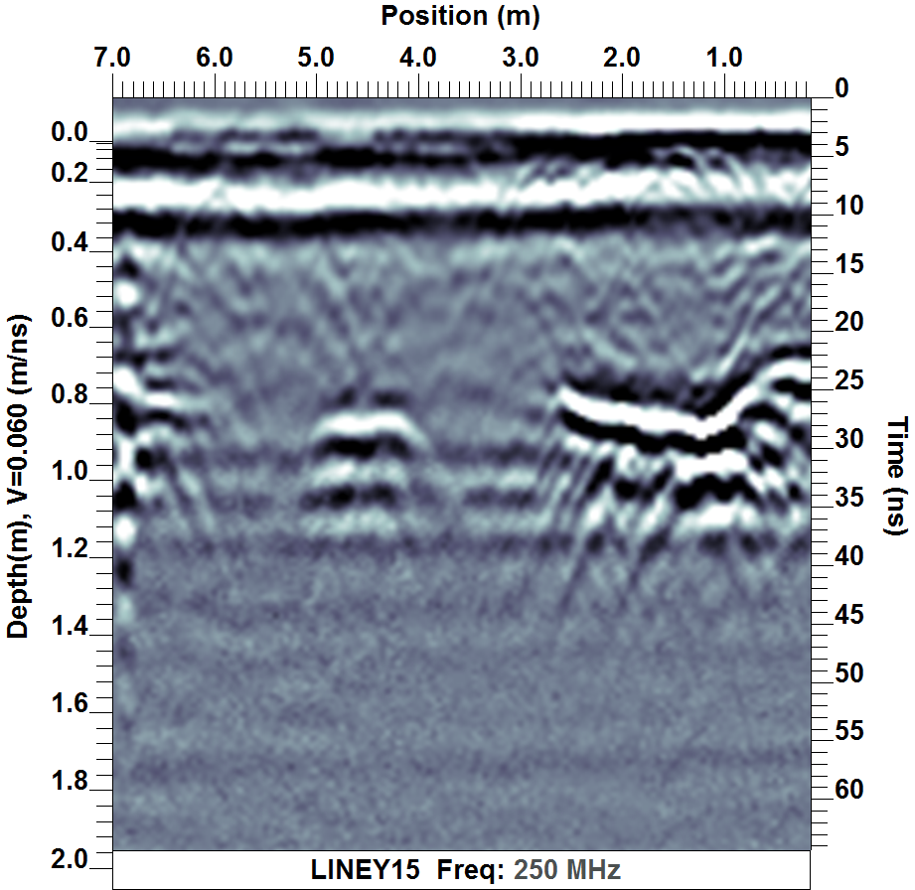
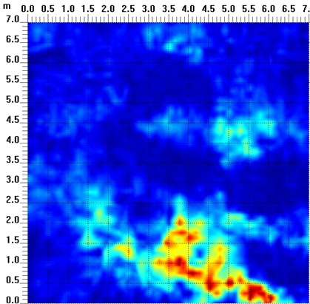
Result: West survey
GPR section
Depth = 0.57 m
A
C
A
B
B
C
Notes:
Another profile from the West survey is used to demonstrate how we locate the unmarked burial. The processed data show the distinct diffractions. B and C are known burials due to the presence of headstones. We suspected to 3 more burials along the same line and a strong diffraction was observed marked by A. The length of the burial is estimated around 2 m from the inspection of the hyperbola on the adjacent lines.

Slide 16
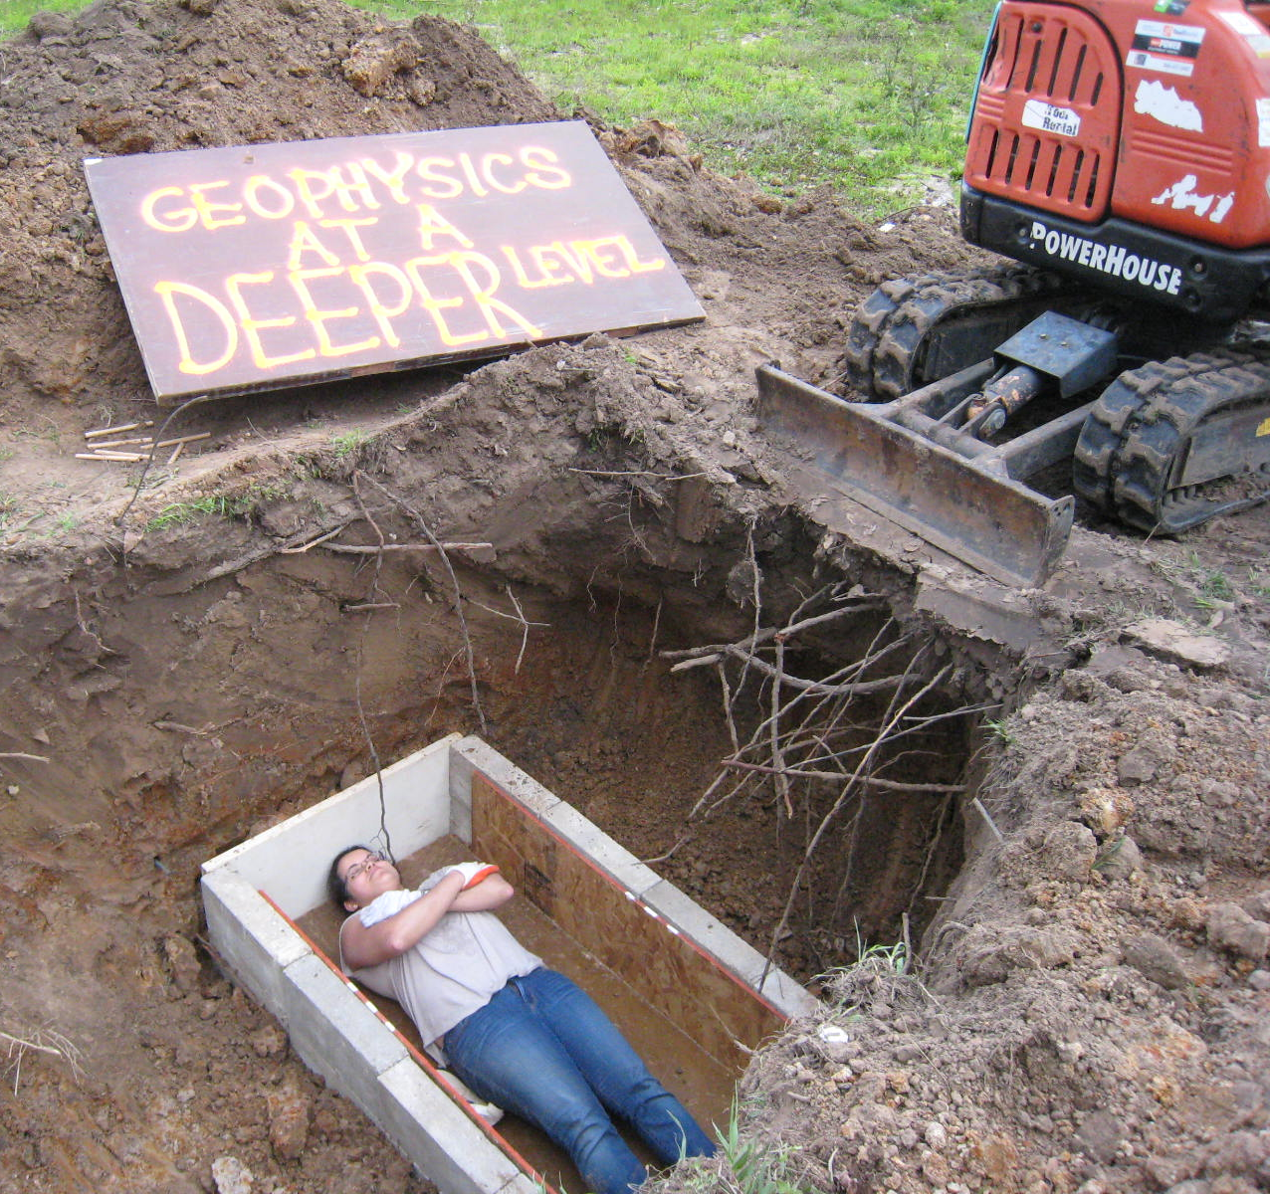
Summary
Culvert imaging is clear with 250 MHz
Velocities in South Houston is 0.08 m/ns
Vaulted burials have distinct GPR signature
Leads for unmarked burials marked by GPR
Velocities in North Houston is 0.06 m/ns
Notes:
In conclusion, I showed two different cases of GPR imaging the culvert tops are evident in the imaging using GPR. The three antennae have their advantages. 1000 MHz is more detail but limited depth. I would say 250 MHz and 1000 MHz are most useful. If we just want to see the presence of the culvert, 100 MHz is good but not the depth estimation. From the survey, we estimated the depth of the soil is 0.08 m/ns. From the burial imaging at Mueschke, we learned different burial types give different diffraction hyperbolas. So far we have found leads of the unmarked burials. From the velocity estimation experiments, we found that the velocity of the soil is 0.06 m/ns.
With that, I conclude my presentation. Thank you.

Slide 17
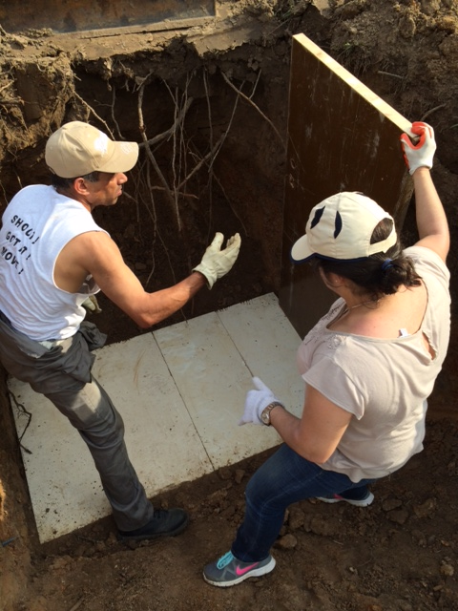
Acknowledgement
Janet Flores, Brian Kyser and (Mueschke)
Rebecca Stone (Muschke)
Dr. Robert Wiley (Mueschke)
Li Chang (Mueschke & culvert)
Ady Geda (Mueschke)
Hongru (Culvert)
Marcus Zinecker (Mueschke)
Yesenia Rivera (Mueschke)
Joan-Marie Blanco (Mueschke)
Vaughn Robla (Mueschke)

Slide 18
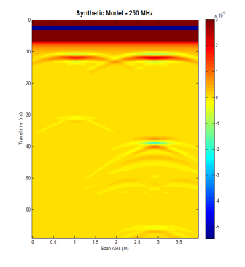
Numerical modeling results
Dry clay
Dry sand
Concrete vs wooden closure

